Slide 1
Topic 13
DEVELOPING TEAMS:
Groups, Teams, and Their Leadership

Slide 2
Groups, Teams, and Their Leadership
“We are born for cooperation, as are the feet, the hands, the eyelids, and the upper and lower jaws.”
-Marcus Aurelius

Slide 3
Groups/Teams
“It is quite possible that the mark of a truly effective internal team leader is to be more of a coach and to empower the team to make its own decisions and govern itself.”
-O’Connell et al., 2002

Slide 4
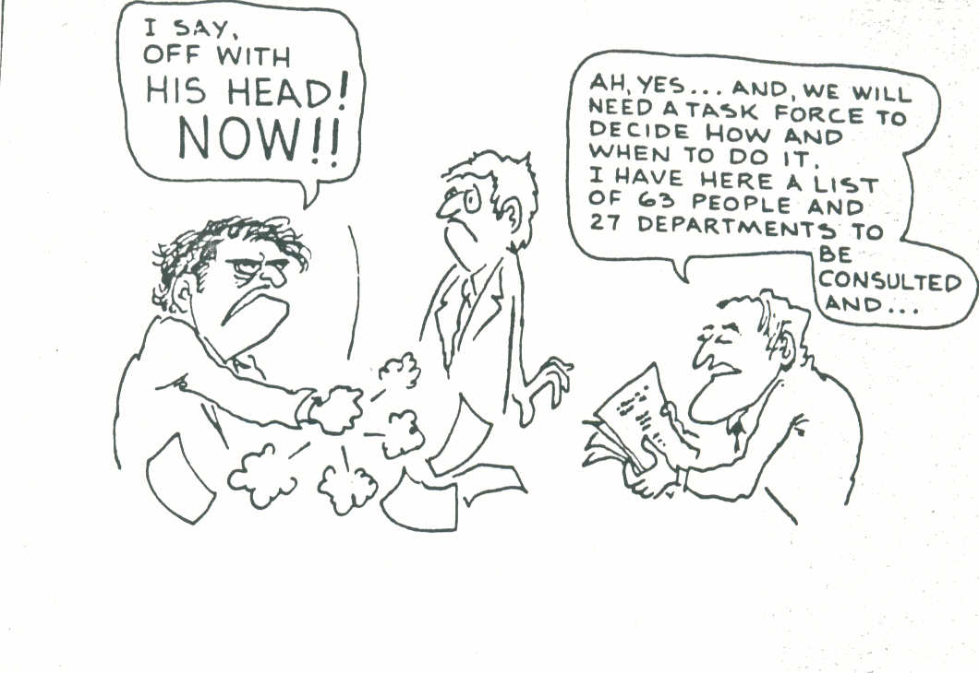

Slide 5
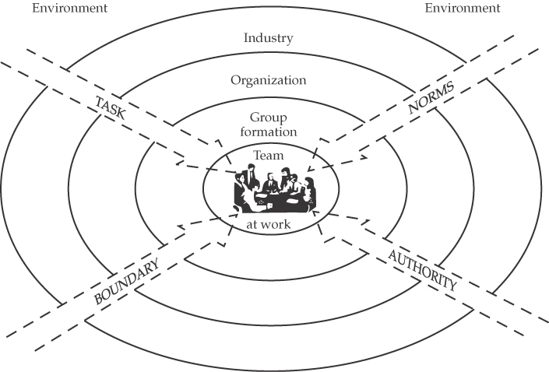
Organizational Shells

Slide 6
Groups / Teams
Talking about formal groups / teams as opposed to informal groups. Informal groups are independently formed to meet the social needs of employees. Leaders can benefit from informal groups, but have no responsibility or accountability for them. Thus, from a leadership perspective our focus is on formal work groups (specifically teams) established by the leader, organization, etc..

Slide 7
Leadership and Work Teams
During the past few decades we have witnessed an increase in the organizational use of work teams.
A group is two or more interdependent individuals who interact with one another to achieve a commonly held objective.
A team is a group of two or more people joined in cooperative activity for work or play.
  All teams are groups, but not all groups are teams.
  Teams exhibit a higher level of cohesiveness than do groups.

Slide 8
Teams, Teamwork, and Groups
A team is a work group that must rely on collaboration if each member is to experience the optimum success and achievement.
Teamwork is done with an understanding and commitment to group goals on the part of all team members.
Perhaps worth repeating----All teams are groups, but not all groups are teams.

Slide 9
Individuals Versus Groups Versus Teams
Team members usually have a stronger sense of identification among themselves than group members do.
Teams have common goals or tasks.
Task interdependence typically is greater with teams than with groups.
Team members often have more differentiated and specialized roles than group members.

Slide 10
Characteristics of Teams
Members are fully committed to common goals they develop
Members are mutually accountable to one another
Members trust one another
Collaborative culture
Shared leadership based on facilitation
Synergy----positive synergy

Slide 11
Types of Teams
Numerous type teams/team structures /purposes for teams exist.
Selected examples follow:
  Problem-solving teams
  Self-managed work teams
  Cross-functional teams
  Virtual teams

Slide 12
Types of Teams
Problem-solving Teams
  Employees from the same department and functional area who are involved in efforts to improve work activities or to solve specific problems, handle specific issues, matters, etc.
Self-managed Work Teams
  A formal group of employees who operate without a manager responsible for a complete work process or segment.

Slide 13
Types of Teams Cont.
Cross-functional Teams
  Hybrid grouping of individuals who are experts in various specialties and who work together on specific tasks----many times from differing positional levels in the organization----their experience is often temporary , with the team disbanding when the task is completed.
Virtual Teams
  Teams that use technology to link physically dispersed members in order to achieve a common goal.

Slide 14
The Impact of Team Size
The greater the number of people in a large versus a small team will affect the probability that any individual is likely to emerge as leader.
As teams become larger, cliques are more likely to develop.
Leaders with a large span of control tend to be more directive, spend less time with individuals, and use more- impersonal approaches when influencing others.

Slide 15
Team Size
Small teams
  Complete tasks faster than larger groups
  Make more effective use of facts
Large teams
  Solve problems better than small groups
  Are good for getting diverse input
  Are more effective in fact-finding
Social Loafing
  The tendency for individuals to expend less effort when working collectively than when working individually.
The Magic Number----(????)

Slide 16
Bruce Tuckman’s Research
Tuckman’s research delineated stages of Group Development-----applicability to teams.

Slide 17
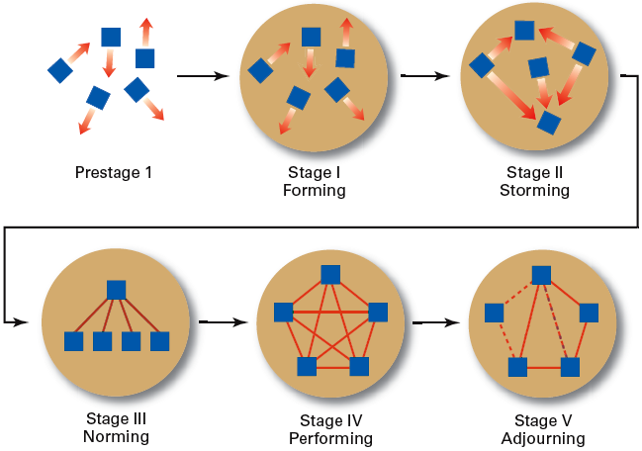
Stages of Group Development
Exhibit 15.2

Slide 18
Stages in Group Development
Forming
  Members join and begin the process of defining the group’s purpose, structure, and leadership (mutual acceptance).
Storming
  Intragroup conflict occurs as individuals resist control by the group and disagree over leadership (communication and decision-making).
Norming
  Close relationships develop as the group becomes cohesive and establishes its norms for acceptable behavior (motivation and productivity).
Performing
  A fully functional group structure allows the group to focus on performing the task at hand (control and organization).
Adjourning
  The group prepares to disband and is no longer concerned with high levels of performance.

Slide 19
Team Structure
Role
  The set of expected behavior patterns attributed to someone who occupies a given position in a social unit that assist the team in task accomplishment or maintaining member satisfaction. Beware the following:
  Role conflict: experiencing differing role expectations.
  Role ambiguity: uncertainty about role expectations

Slide 20
Task Roles in Teams
(original work done by Bruce Tuckman regarding groups)
Team task roles are roles that help the team develop and accomplish its goals.
Initiator-Contributor
  Proposes goals, suggests ways of approaching tasks, and recommends procedures for approaching a problem or task.
Information Seeker
  Asks for information, viewpoints, and suggestions about the problem or task.
Information Giver
  Offers information, viewpoints, and suggestions about the problem or task.

Slide 21
Task Roles in Teams Cont.
Coordinator
  Clarifies and synthesizes various ideas in an effort to tie together the work of the members.
Orienter
  Summarizes, points to departures from goals, and raises questions about discussion direction.
Energizer
  Stimulates the team members to higher levels of work and better quality.

Slide 22
Relationship Roles or Maintenance Roles in Teams
Team maintenance roles do not directly address a task itself but instead help foster team unity, positive interpersonal relations among team members, and development of the ability of members to work effectively together.
Harmonizer
  Mediates disagreements between other members and attempts to help reconcile differences.
Encourager
  Expresses warmth and friendliness toward group members, encourages them, and acknowledges their contributions.

Slide 23
Relationship Roles or Maintenance Roles in Teams Cont.
Gatekeeper
  Tries to keep lines of communication open and promotes the participation of all team members.
Standard Setter
  Suggest standards for how the team should operate and checks whether members are satisfied with the team’s functioning.
Team Observer
  Watches the internal operations of the team and provides feedback about how participants are doing and how they might be able to function better.
Passive Follower
  Agrees with team members and is friendly but relatively passive.

Slide 24
Dysfunctional Roles in GROUPS (Self-oriented Roles)
Self-oriented roles are related to the personal needs of group members and often negatively influence the effectiveness of a group.
Aggressor
  Deflates the contributions of others by attacking their ideas, ridiculing their feelings, and displaying excessive competitiveness.
Blocker
  Tends to be negative and stubborn and to resist new ideas, sometimes in order to force the group to readdress a viewpoint with which they have already dealt.

Slide 25
Dysfunctional Roles in Groups (Self-oriented Roles) Cont.
Recognition-seeker
  Seeks attention, boasts about accomplishments and capabilities, and works to prevent being placed in an inferior position in the group.
Dominator
  Tries to assert control and manipulates the group or certain group members through such methods as flattery, giving orders, or interrupting others.

Slide 26
Team Structure (cont’d)
Norms
  Acceptable standards or expectations that are shared by the team’s members.
  Common types of norms
    Effort and performance
      Output levels, absenteeism, promptness, socializing
    Loyalty
    Commitment

Slide 27
Team Structure (cont’d)
Conformity
Individuals conform in order to be accepted by teams
Team pressures can have an effect on an individual member’s judgment and attitudes

Slide 28
Team Structure (cont’d)
Team Cohesiveness
  The degree to which members are attracted to a team and share the team’s goals.
    Highly cohesive teams are more effective and productive than less cohesive groups / teams when their goals are aligned with organizational goals.

Slide 29
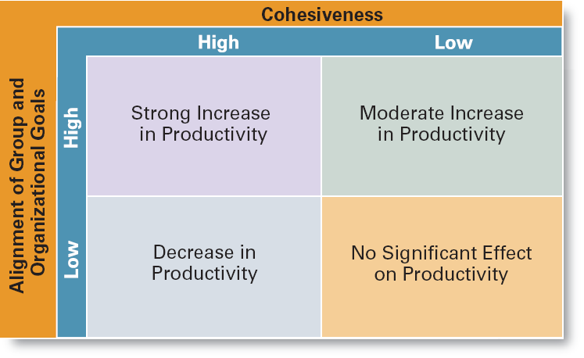
The Relationship Between Cohesiveness and Productivity
Exhibit 15.5

Slide 30
Team Cohesion
Team cohesion: The glue that keeps a team together.
Highly cohesive teams interact with and influence each other more than do less cohesive teams.
  Greater cohesiveness most often but not always leads to higher performance.
  Highly cohesive teams may have lower absenteeism and lower turnover.
  Highly cohesive teams may sometimes develop goals contrary to the larger organization’s goals.

Slide 31
Cohesion (Positive)
Leaders will be better off thinking of ways to create and maintain highly cohesive teams, than not developing these teams out of concern for potential groupthink or overbounding situations.

Slide 32
Groupthink
(Based on the work of Irving Janis)
The extensive pressure of others in a strongly cohesive or threatened group that causes individual members to change their opinions to conform to that of the group.
With groupthink, the positive value of cohesion turns negative.

Slide 33
Symptoms of Groupthink
Illusion of invulnerability
Unquestioned assumption of the group’s morality
Collective rationalization
Self-censorship
Illusion of unanimity
Direct pressure on dissenting members
Mindguards

Slide 34
Team Cohesion (Negative Cont.)
Overbounding: Tendency of highly cohesive groups to erect what amount to fences or boundaries between themselves and others.
Groupthink: People in highly cohesive teams often become more concerned with striving for unanimity than in objectivity appraising different courses of action.
Ollieism: When illegal actions are taken by overly zealous and loyal subordinates who believe that what they are doing will please their leaders.

Slide 35
Symptoms of Unproductive Teams
Guarded Communication
Lack of Disagreement
Personal Criticism
Malfunctioning Meetings
Ambiguous Goals
Low Commitment
Conflict within the Team

Slide 36
Characteristics of Effective Teams
A clear mission and high performance standards
Leaders of effective teams spent a considerable amount of time assessing the technical skills of the team members.
After taking stock of available resources and skills, good leaders would work to secure those resources and equipment necessary for team effectiveness.

Slide 37
Characteristics of Effective Teams
Leaders of effective teams would spend a considerable amount of time planning and organizing in order to make optimal use of available resources, to select new members within needed technical skills, or to improve needed technical skills of existing members.
High levels of communication
Minimize interpersonal conflicts

Slide 38
Characteristics of Followers in High Performing Teams
Cohesion
Supporting top leadership
Raising issues with top leadership
Taking initiative
Taking personal responsibility for team performance

Slide 39
Three Critical Functions for Team Leadership
Direction
Design
Development

Slide 40
What are Team-Leader Values?
Put team members first
Trust team members
Help members to self-actualize
Develop capabilities of the team
Believe that teamwork is important
Delegate responsibilities
Minimize barriers to success

